Slide 1

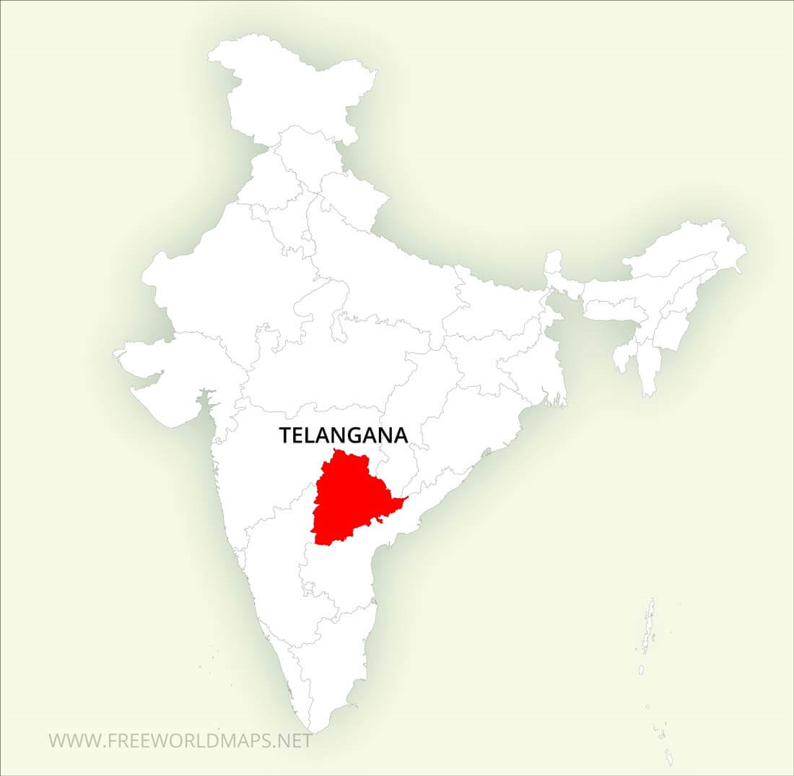
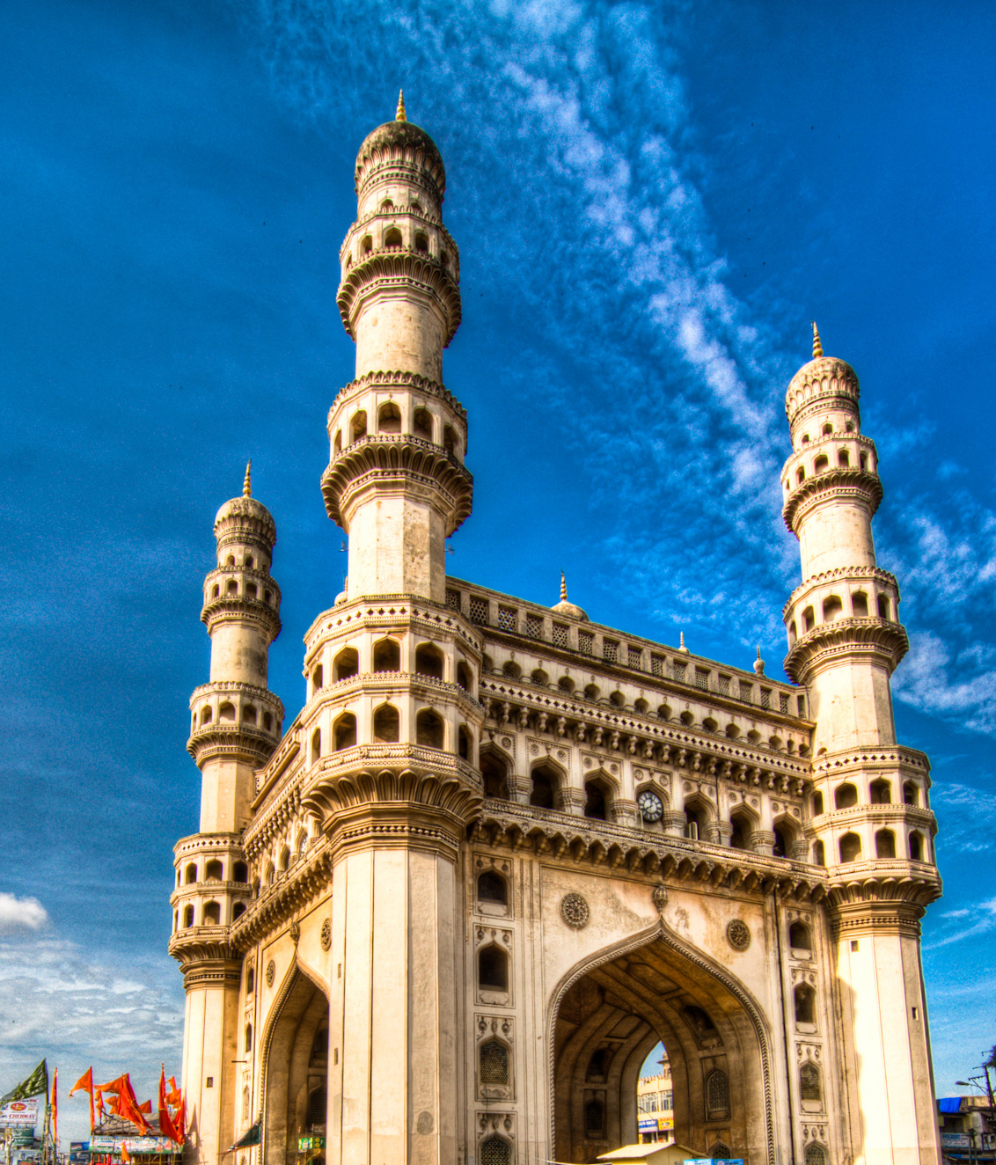
TELANGANA TOURISM ANALYSIS
Domain – Tourism
Tools – MySQL, Power BI, PowerPoint
Created by. – Deepak P.

Slide 2
Problem Statement
The aim is to find the patterns in the given data, do additional research, and give data-informed recommendations to the Telangana government which can be used to increase their revenue by improving administrative operations.

Slide 3
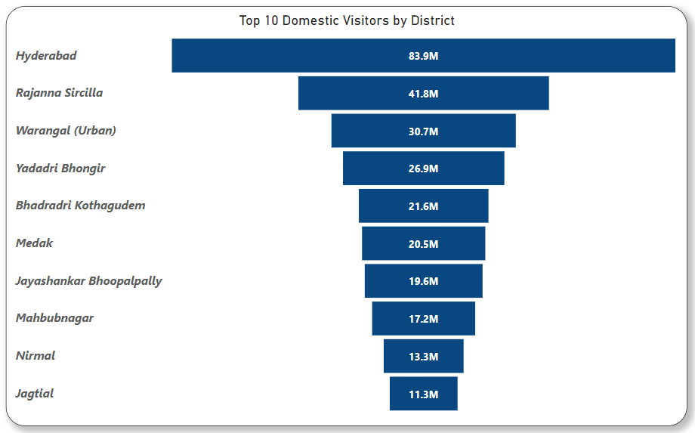
Top 10 Domestic District where Visitor Like to Visit the Most
Hyderabad is the most popular tourist place for Domestic people with 83.9 Millions visitors from 2016 - 2019 . Some of the most popular attractions are Charminar, Golkonda Fort.
Rajanna Sircilla, Warangal (Urban) are the Second, Third Most District

Slide 4
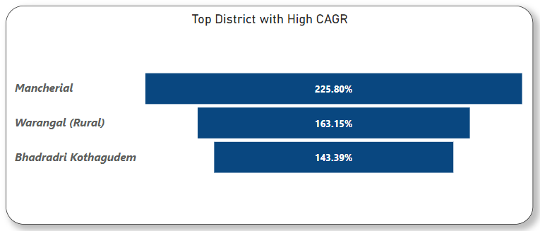
Top 3 District with High CAGR
Mancherial has the highest growth rate of CAGR 225.8% are not in Top 10 district list.
While Bhadradri Kothagudem are having CAGR of 143.39% resp. also present in Top 10 Domestic Visitor list. So expected to have better growth rate in future.
CAGR stands for Compound Annual Growth Rate. It is the measure annual growth rate over time, with the effect of compounding taken into account. It is often used to measure and compare the past performance or to project their expected future returns.

Slide 5
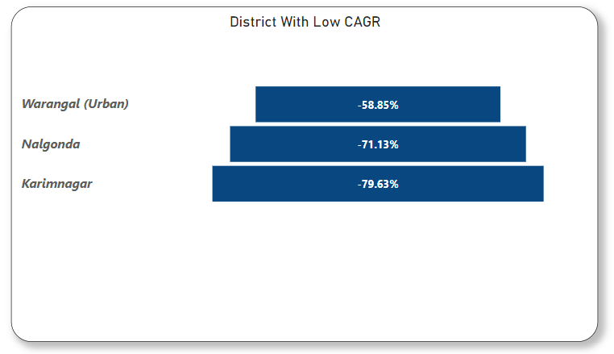
Bottom 3 District with CAGR
Karimnagar has the lowest growth rate of CAGR -79.63% followed by Nalgonda, Warangal (Urban) with CAGR -71.13%, -58.85%.
Insight : Focus on Warangal (Urban) as Rural is growing with CAGR 163%.
Suggestion : Govt. should do advertisement on Cuisines, Tourist place during festival to attract the people. Also Govt. should build infrastructure in Warangal (Urban)
CAGR stands for Compound Annual Growth Rate. It is the measure annual growth rate over time, with the effect of compounding taken into account. It is often used to measure and compare the past performance or to project their expected future returns.

Slide 6
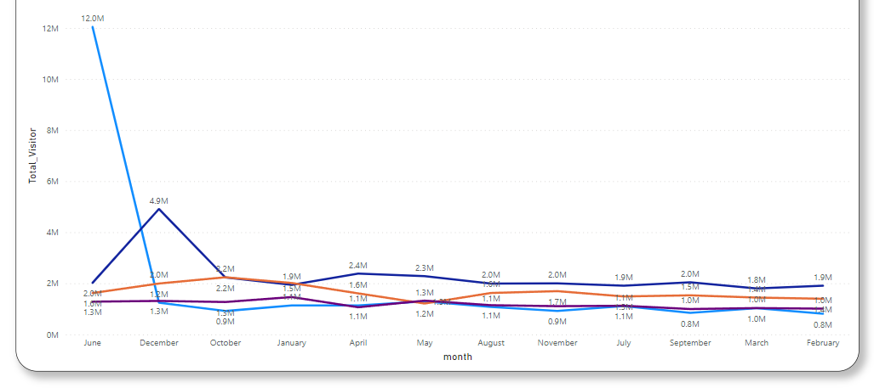
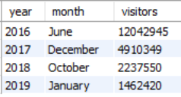
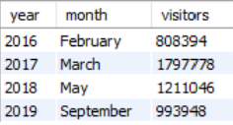
Peak & Low Season for Hyderabad
Visitor are likely to visit in month of June, December, October, January due to cultural festival such as Bonalu, Bathukamma & Christmas as well as Holiday period.
Month of February, March, May, September recorded the lowest visitor due to Exam
PEAK
LOW

Slide 7
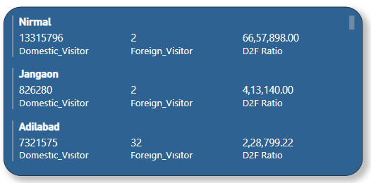
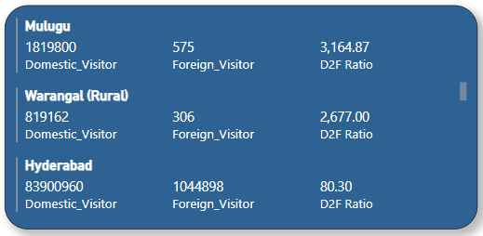
Top & Bottom District based on D2F Ratio
Visitor are likely to visit in month of June, December, October, January due to cultural festival such as Bonalu, Bathukamma & Christmas as well as Holiday period.
Month of February, March, May, September recorded the lowest visitor due to Exam
Domestic to Foreign Ratio (D2F) helps to understand proportion of domestic & foreign visitor in each district. Lower the Ratio Higher the Foreign Visitor

Slide 8
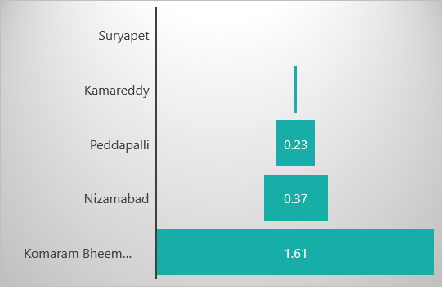
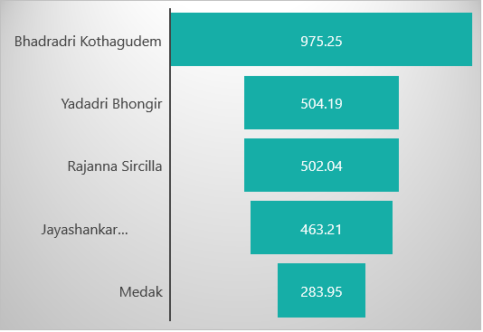
Top & Bottom District based on FOOTFALL Ratio
Bhadradri Kothagudem has higher Footfall Ratio
Komaram has the Lowest Footfall Ratio
Footfall Ratio refer to number of visitor in a particular area. Higher Ratio indicates a Higher number of visitors.

Slide 9
Boost Hyderabad Tourism
Developing infrastructure: Developing and improving infrastructure is essential for attracting more tourists.
Promoting cultural and historical sites: Telangana has a rich cultural and historical heritage that can be leveraged to attract more tourists. Promoting famous sites such as the Charminar, Golconda Fort, and Ramappa Temple, along with lesser-known attractions
Marketing and advertising: Effective marketing and advertising campaigns can help to increase awareness of Telangana as a tourist destination. The use of social media platforms, travel blogs, and online travel guides can help in reaching a wider audience.
Hosting festivals and events: Telangana hosts a number of cultural and religious festivals throughout the year, such as Bathukamma and Bonalu.
Offering adventure tourism: Adventure tourism, such as trekking, camping, and water sports, can be promoted in Telangana to attract adventure enthusiasts.

